Slide 1
Pickett’s Charge
R. Lawrence Comstock
SBCWRT
October 27, 2009

Slide 2
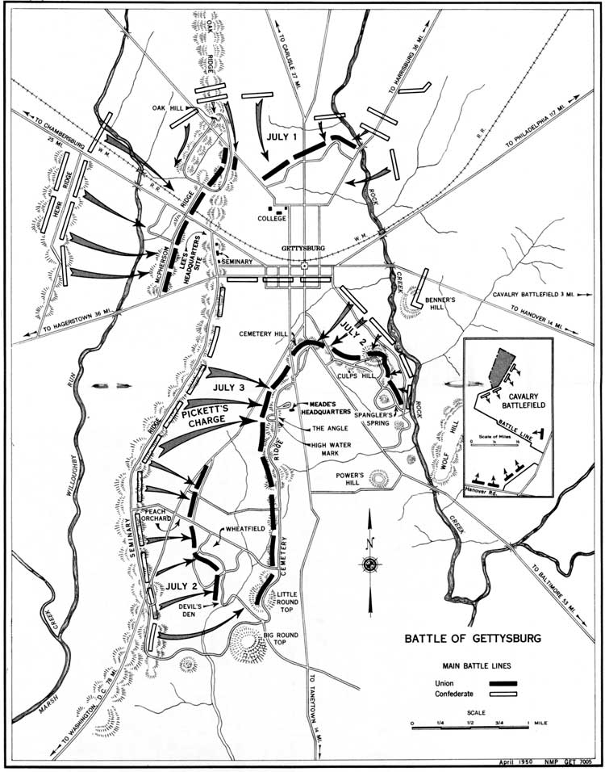
Overall View of the Three-Day Battle of Gettysburg

Slide 3
End of Second Days Fighting
Army of Northern Virginia breached Army of the Potomac’s defensive Line
  Lower Culp’s Hill
  Devil’s Den
  Peach Orchard
  Wright’s Brigade had reached the center of Cemetery Ridge

Slide 4
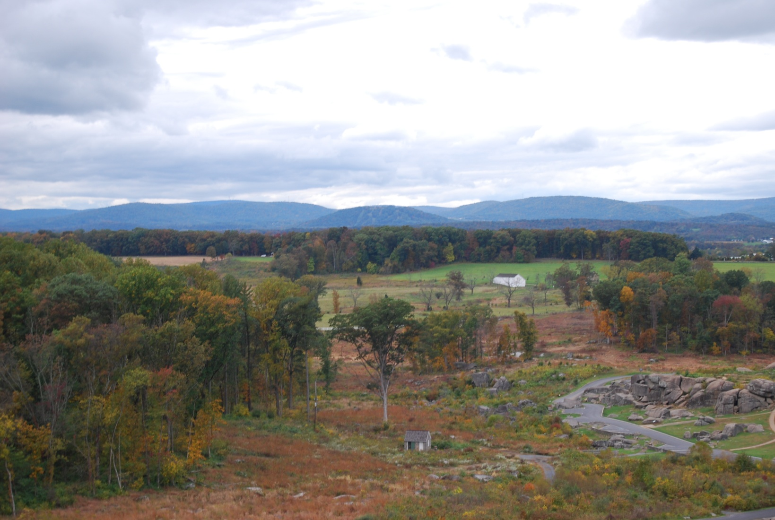
Devil’s Den from Little Round Top

Slide 5
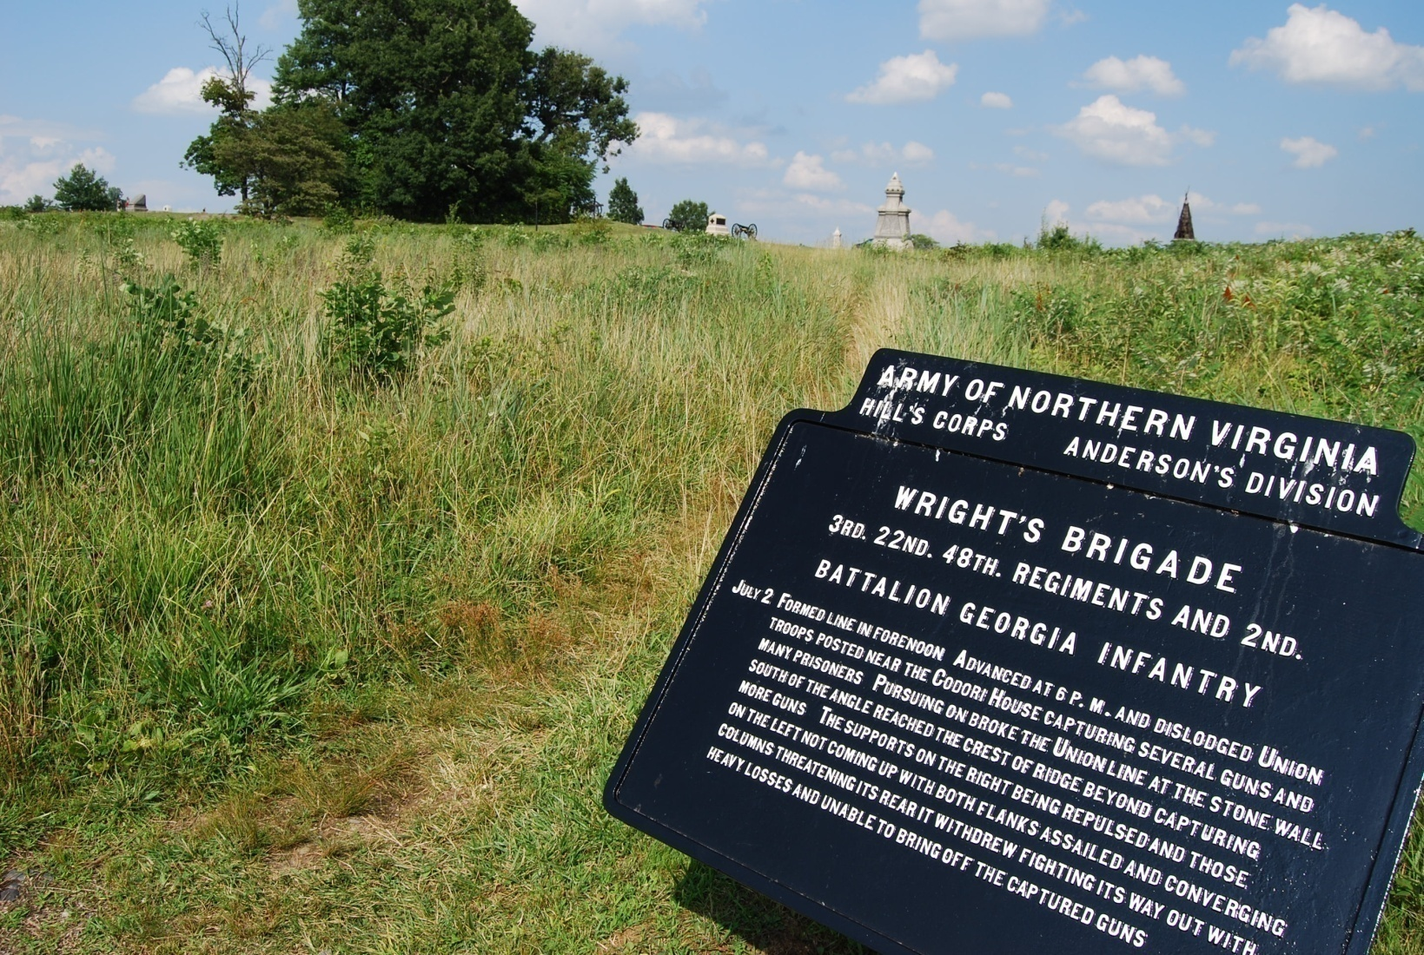
Wright’s Brigade (Anderson’s Division, Hills Corps) Breached Union Line

Slide 6
The Status of the Army of Northern Virginia at end of Second Days Battle
Far from base of supplies in Virginia
Enough artillery ammunition for one major battle
Important positions seized on Union flanks but attacks were not ”in concert”
Major losses in men (20,000 total). One fresh division
(Pickett in I Corps)
Strong desire to achieve a major victory in North

Slide 7
General Lee’s Alternatives for the Third Day
Move around Union left flank and attack from the rear
Continue to attack flanks of Union forces
Attack the Union center
Retreat and return to Virginia with supplies gathered in Pennsylvania
Move from Gettysburg and assume a defensive position in Maryland (Longstreet)

Slide 8
General Lee’s Plan for the 3rd Days Battle
Early morning battle on Lower Culp’s Hill forced Lee to abandon plan for coordinated attack in center and Confederate left flank
Bring Forward Pickett’s Division of Longstreet’s 1st Corps
Pickett (1st Corps), Pettigrew and Trimble (both from 3rd Corps) to attack center of Union line
  Preceded by major artillery barrage
  General Longstreet to plan and lead attack
J.E.B. Stuart’s Cavalry in rear of Union line to support a breakthrough

Slide 9
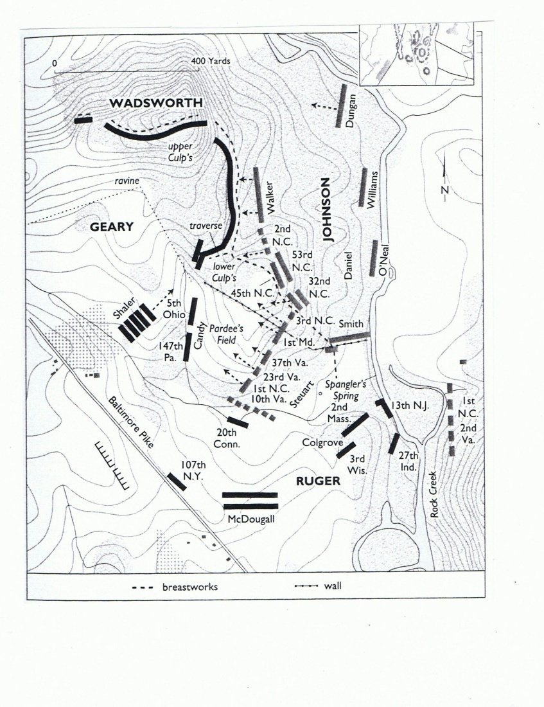
Ewell’s Attack on Lower Culp’s Hill Morning of July 3

Slide 10
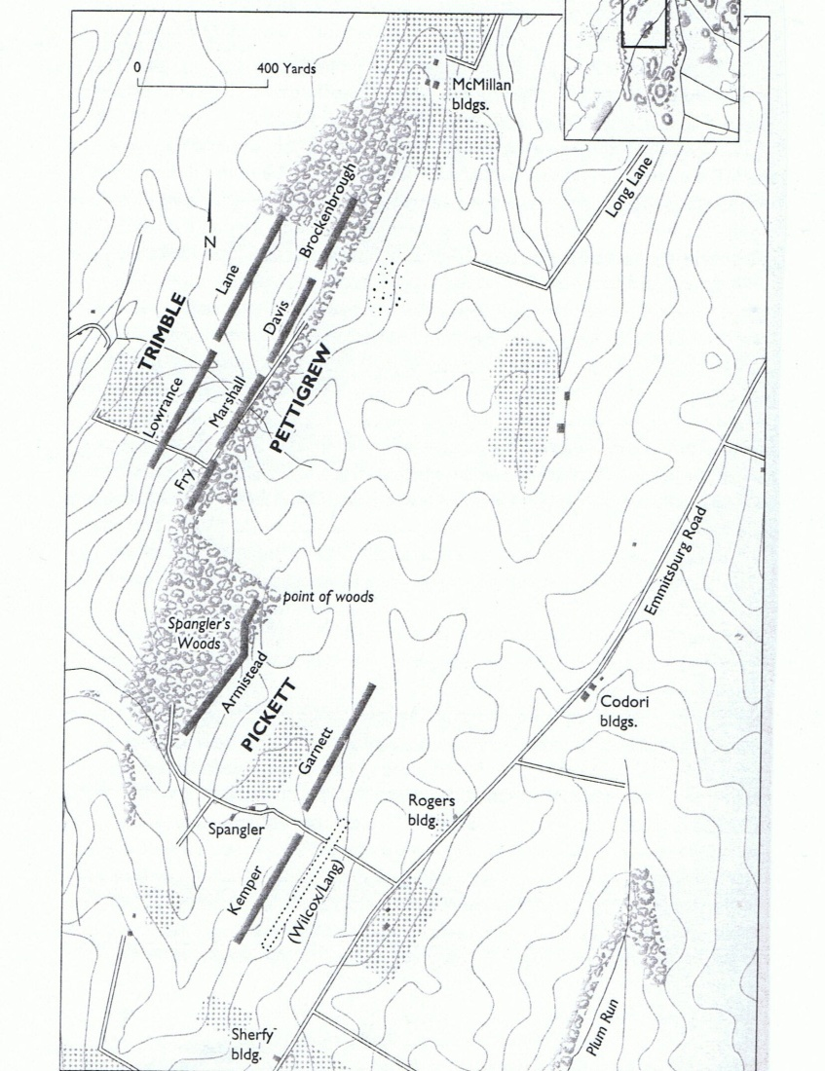
Pickett, Pettigrew and Trimble Divisions Form for the Charge

Slide 11
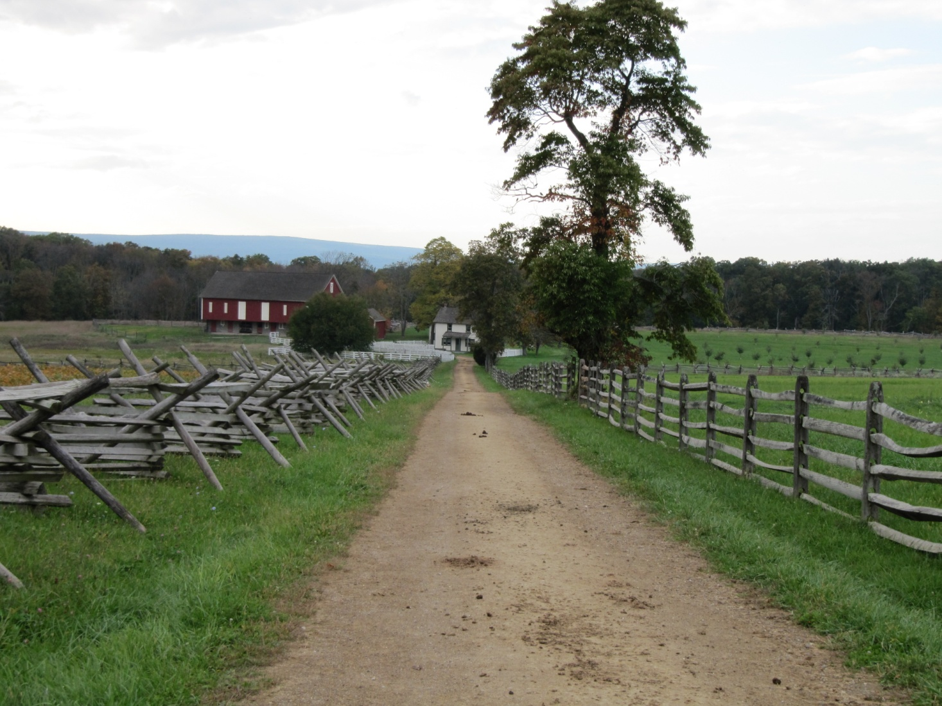
Spangler’s Lane-Separates Garnett and Kemper Brigades

Slide 12
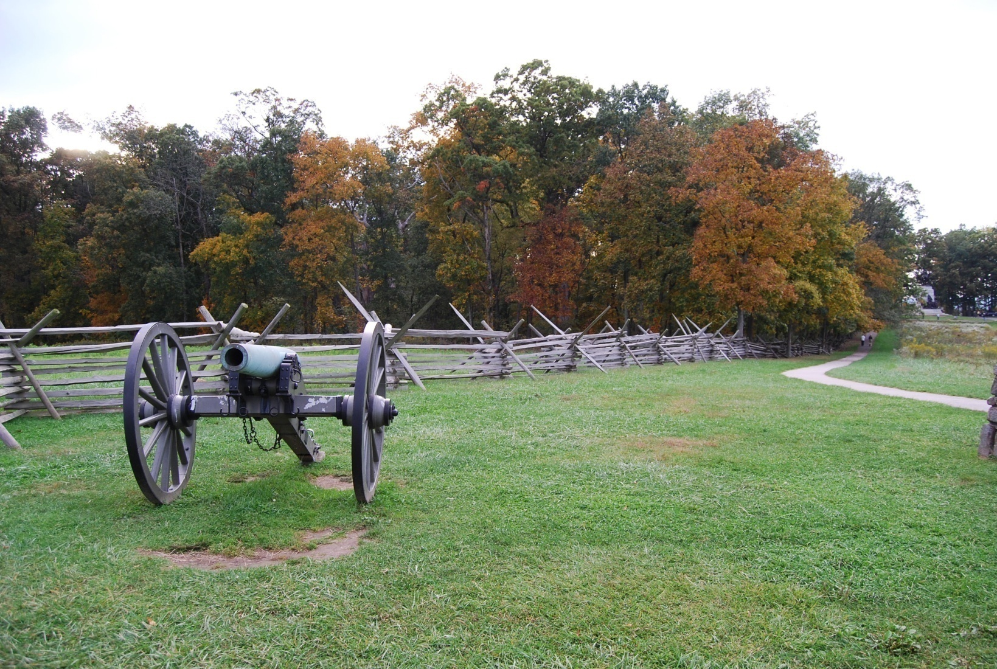
Point of Woods-Separates Pickett and Pettigrew Divisions

Slide 13
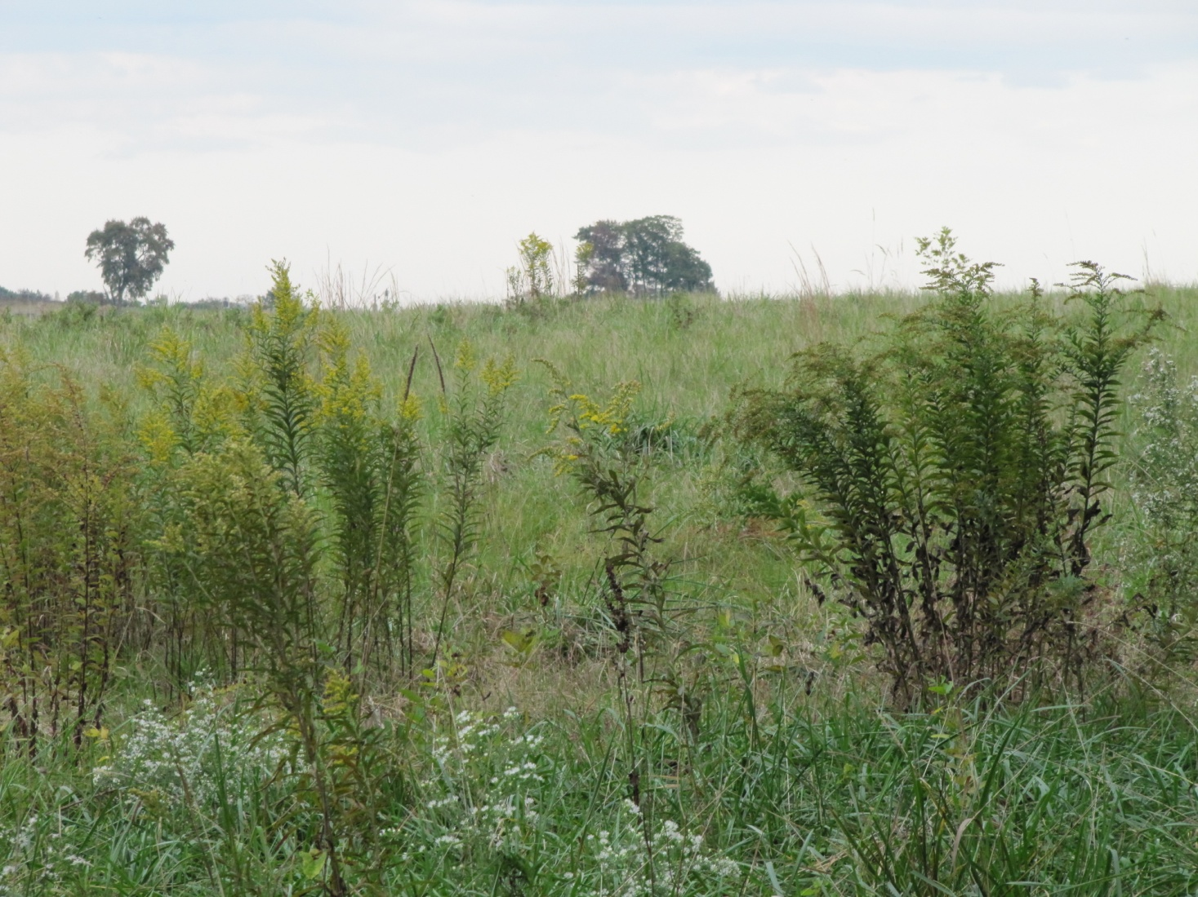
Kemper’s Brigade Position in Swale

Slide 14
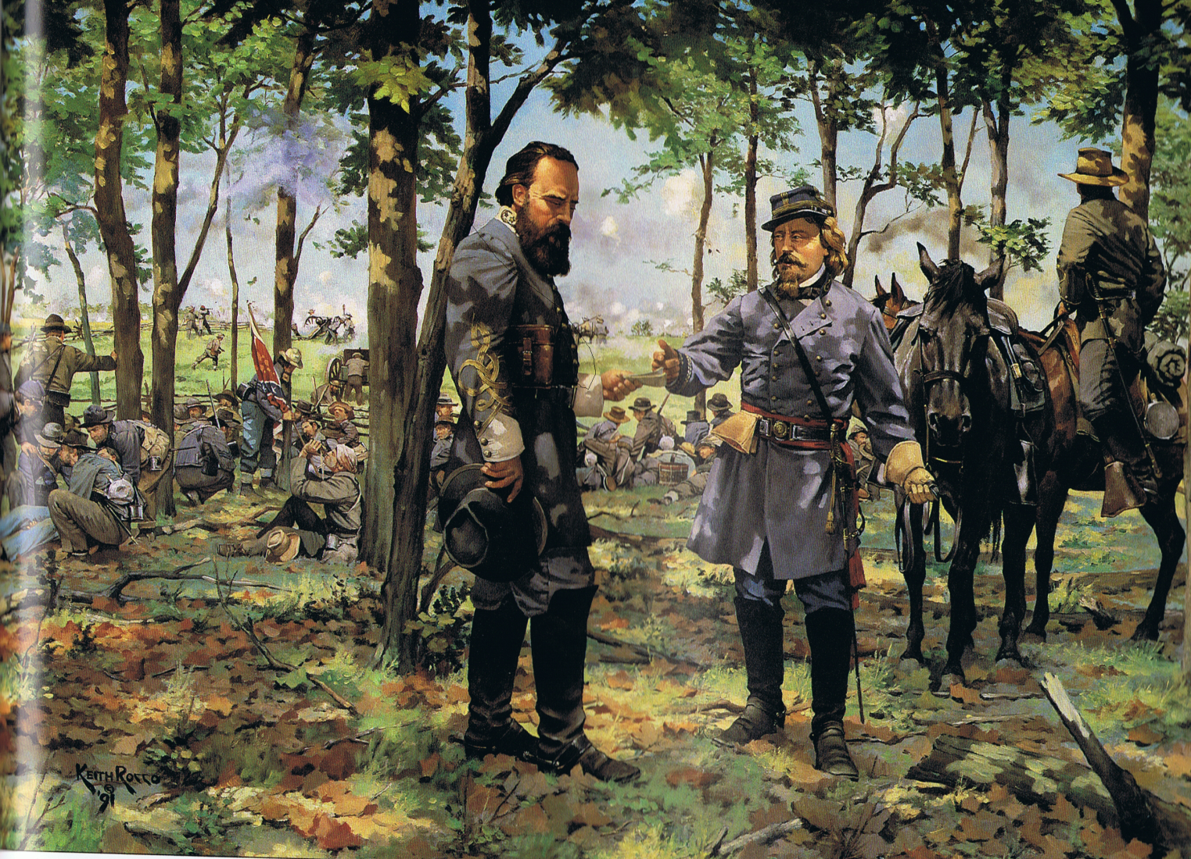
General Longstreet and General Pickett

Slide 15
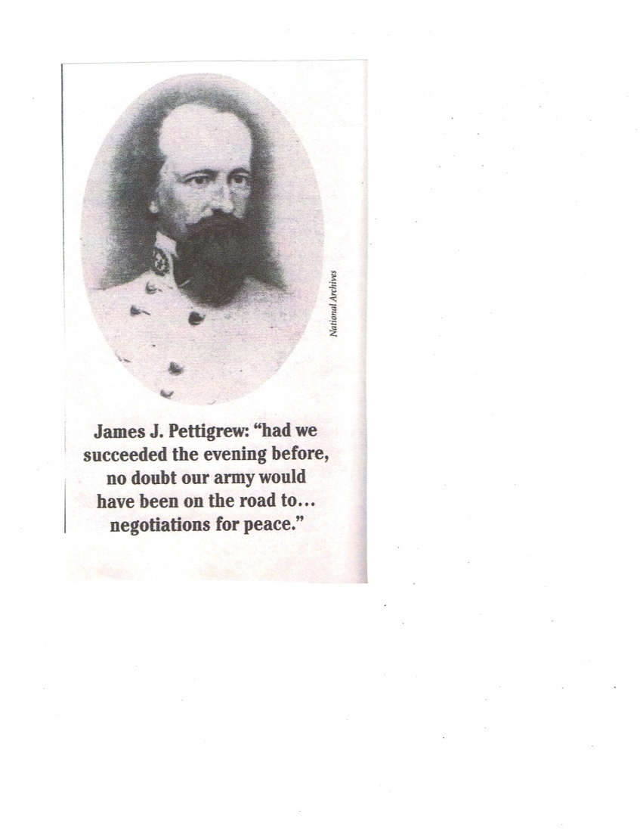
General James Johnston Pettigrew

Slide 16
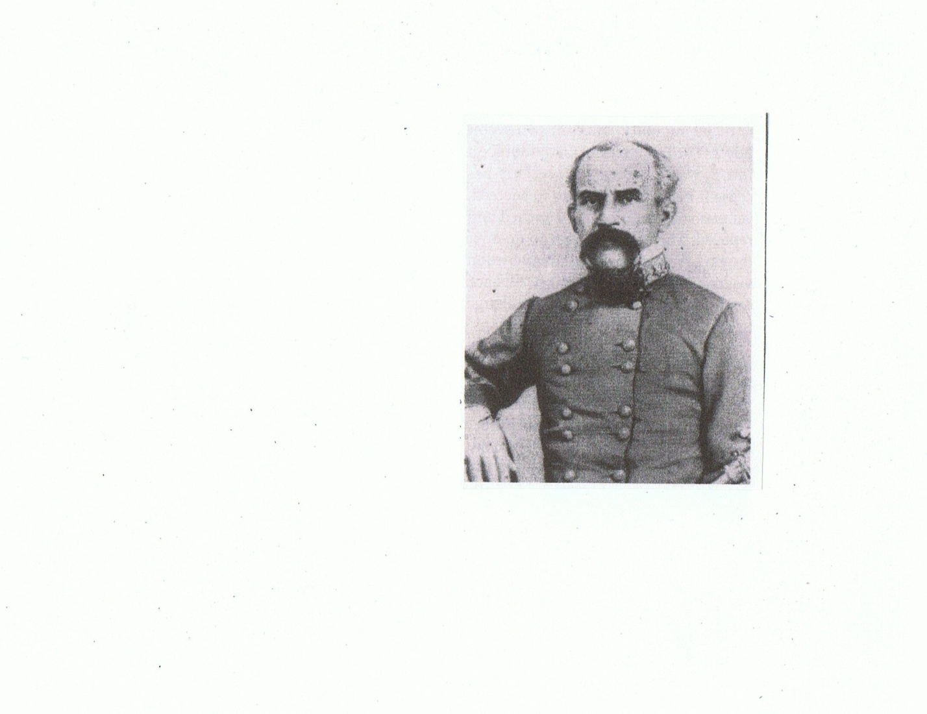
General Isaac Trimble

Slide 17
Brigades in Charge
Pickett 3 Brigades
Pettigrew (Heath wounded on 1st Day) 4Brigades
Trimble (substituting for Pender) 2Brigades
Pickett 6000 men
Pettigrew and Trimble 6500 men

Slide 18
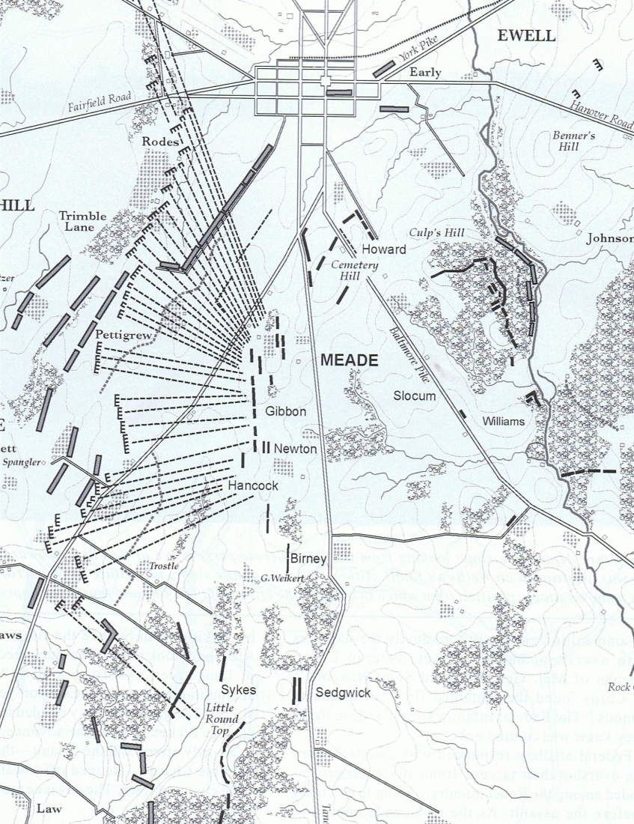
Confederate Artillery Barrage
Objective to silence Union guns in center of Union line
170 guns

Slide 19
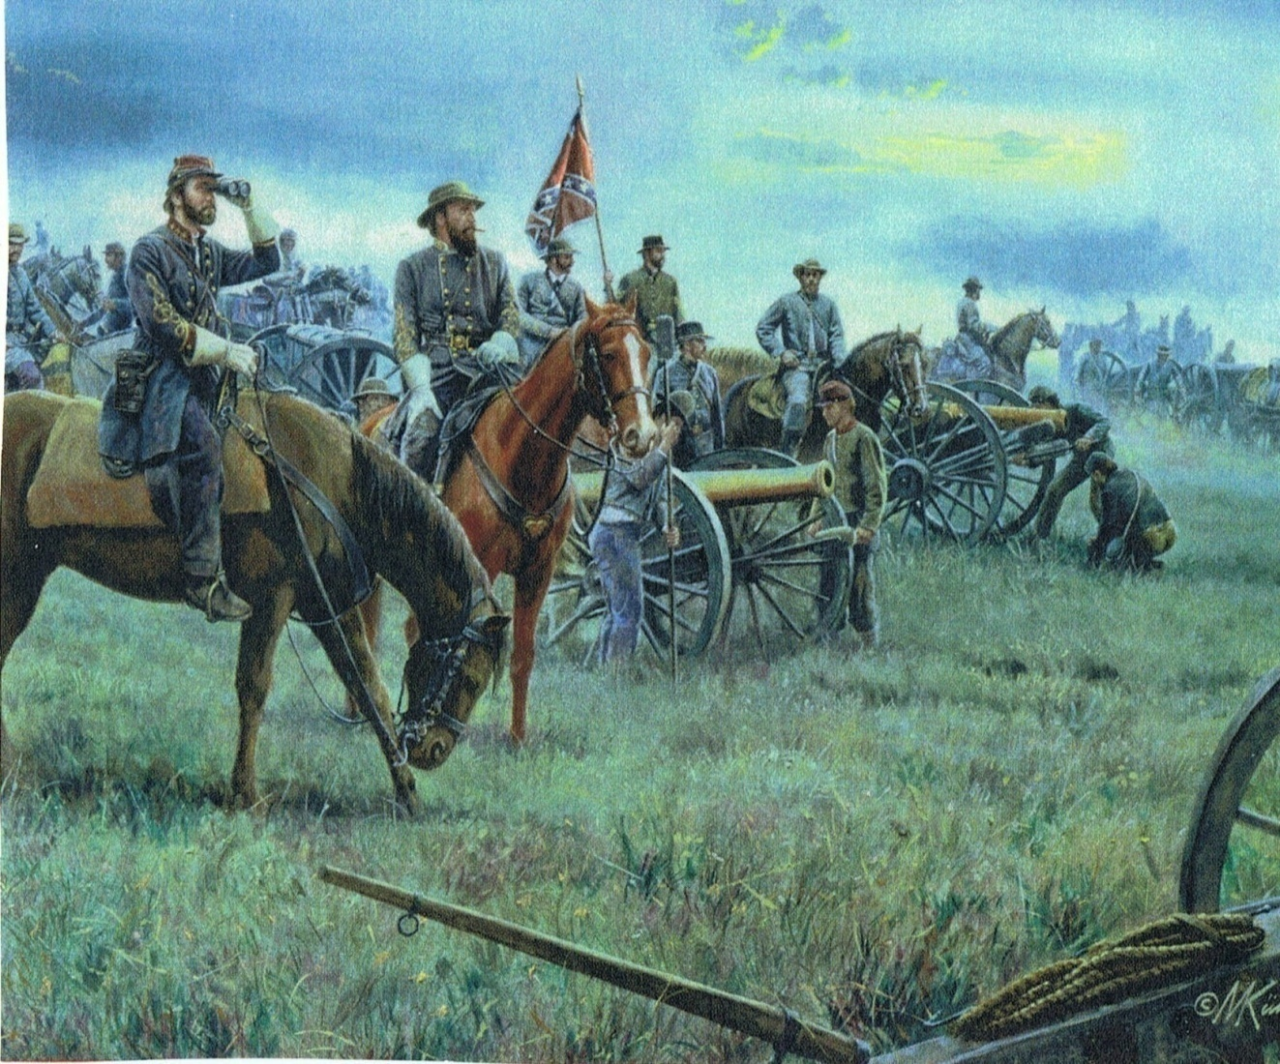
Colonel Alexander and General Longstreet Directing Artillery Barrage

Slide 20
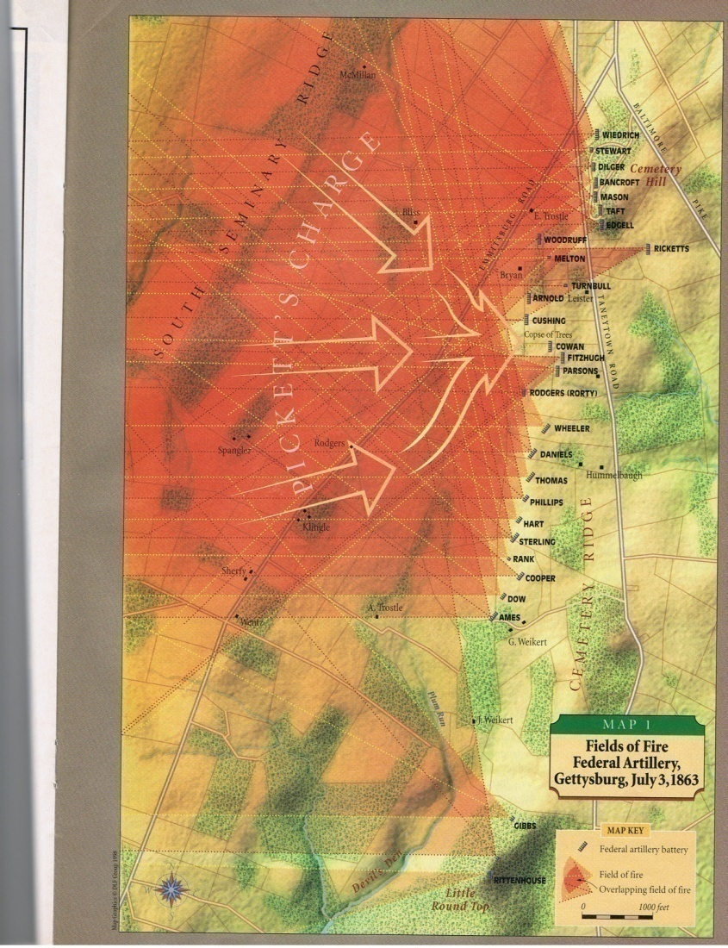
Union Artillery Response to Pickett’s Charge

Slide 21
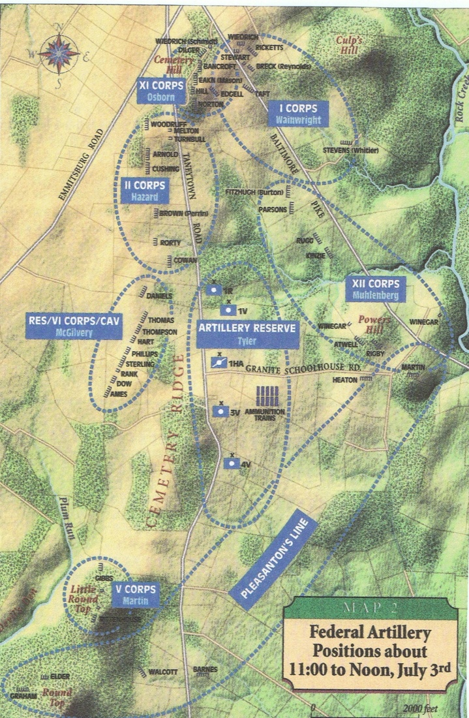
Union Artillery Positions

Slide 22
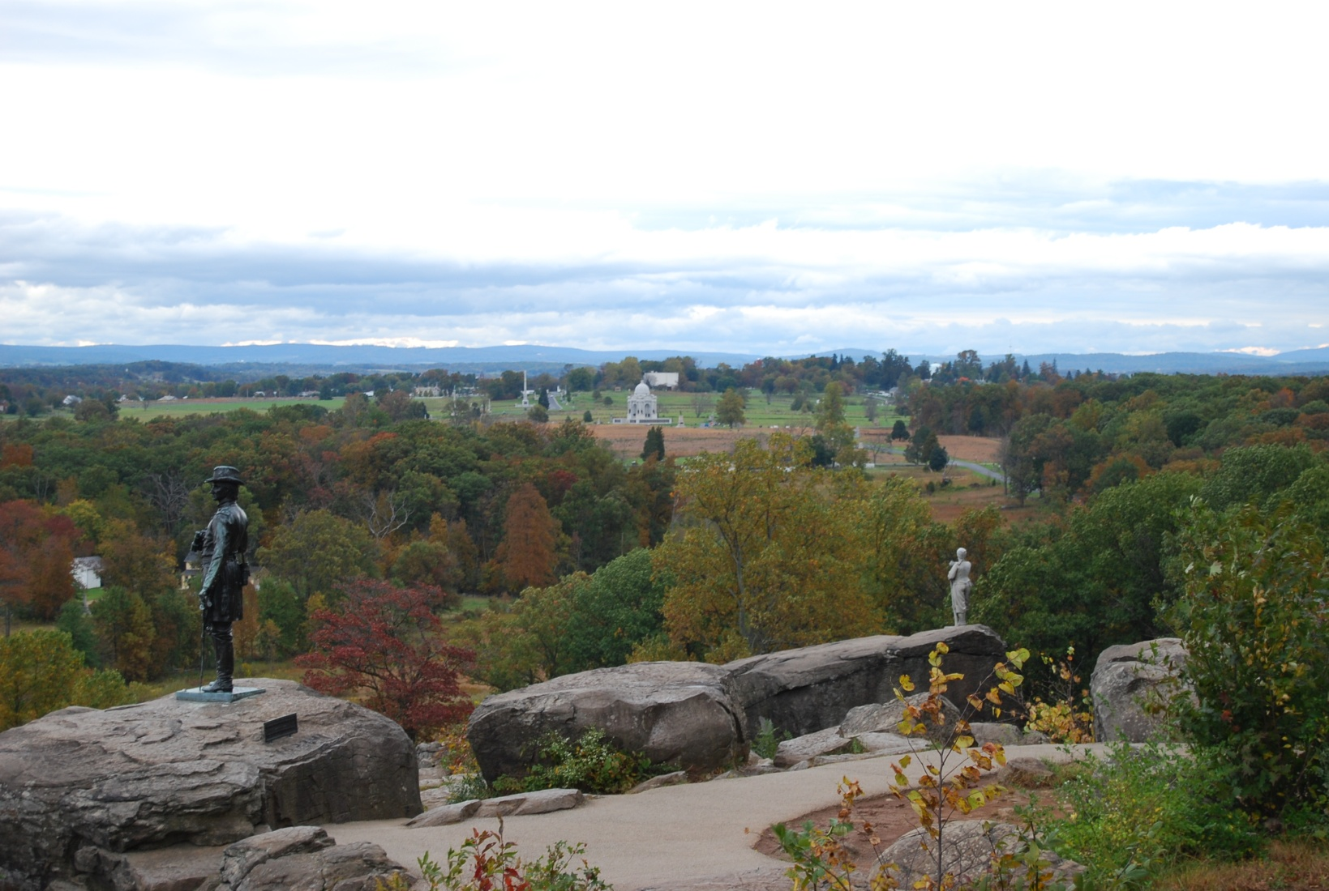
McGilvery’s Battery Position viewed from Little Round Top

Slide 23
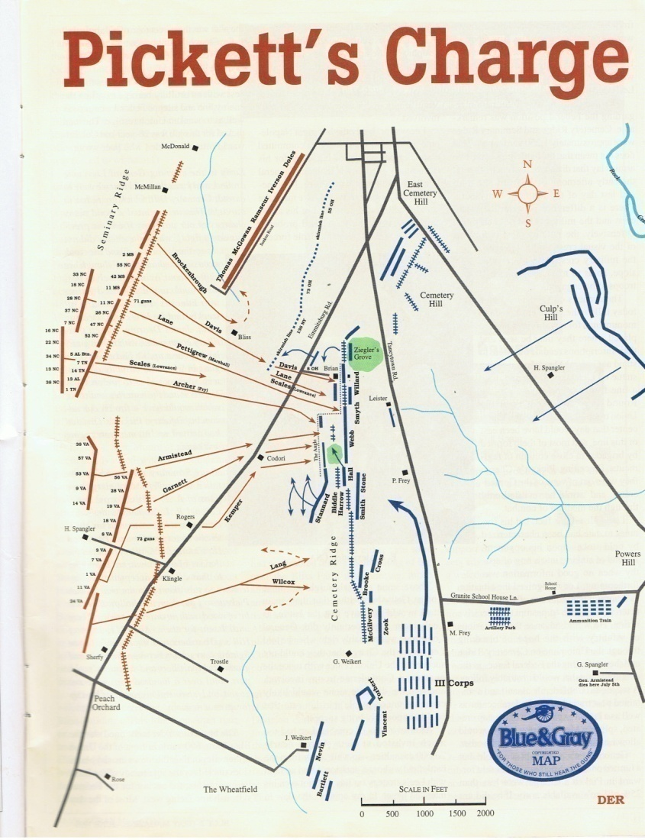
400 yards spacing between Pickett and Pettigrew/Trimble Divisions
Pettigrew attacked straight ahead. Fry on right-flank was “Brigade of Direction”.
Pickett’s Division moved toward the left.
Copse of Trees and “The Angle” dividing line between Pickett and Pettigrew/Trimble

Slide 24
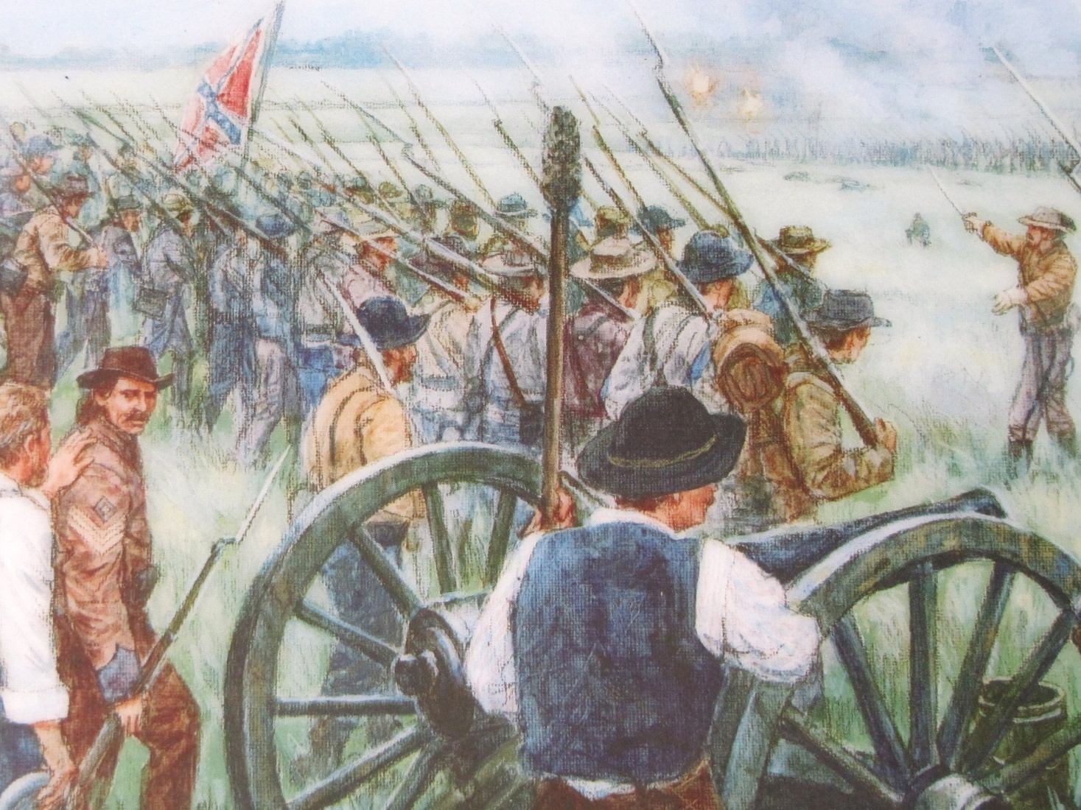
Pickett’s Charge Starts

Slide 25
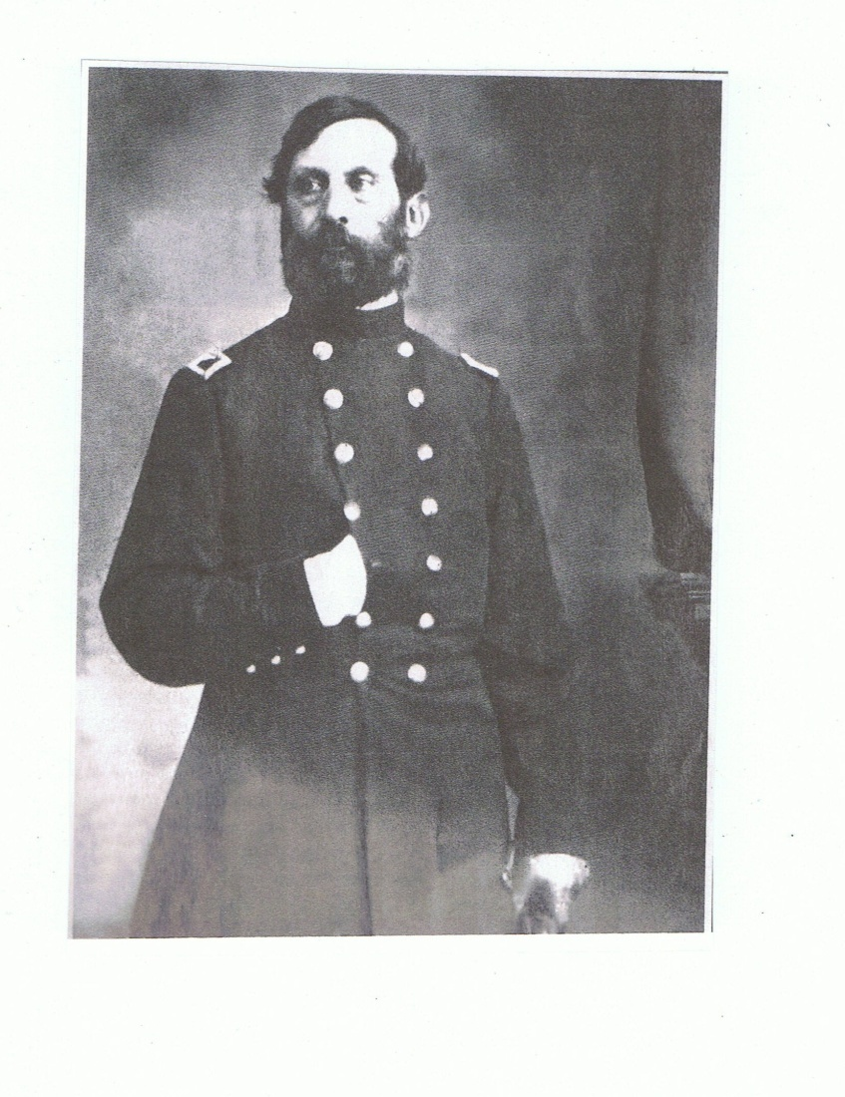
Brigadier General Henry Hunt-Chief of Artillery

Slide 26
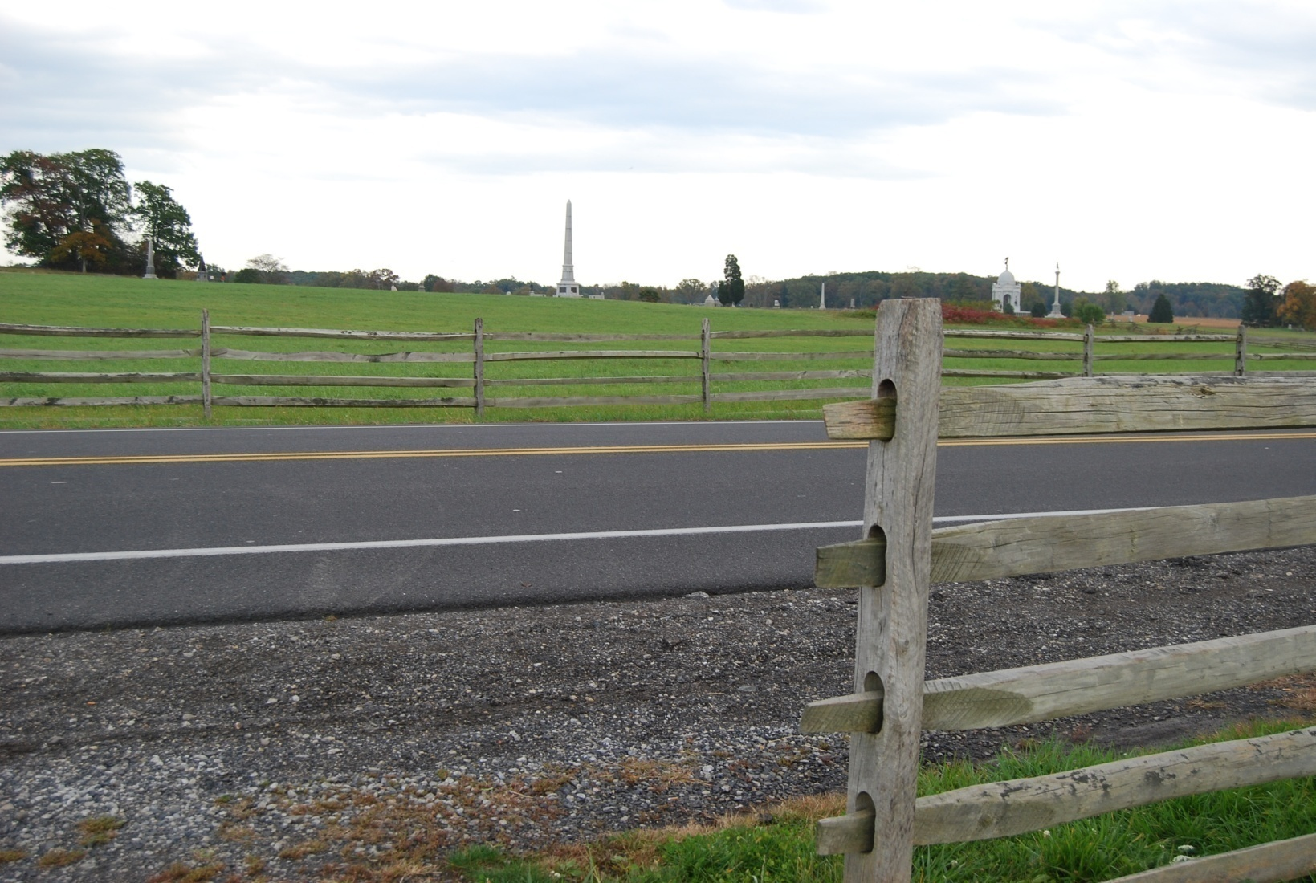
Emmitsburg Road Fences –a Major Obstacle

Slide 27
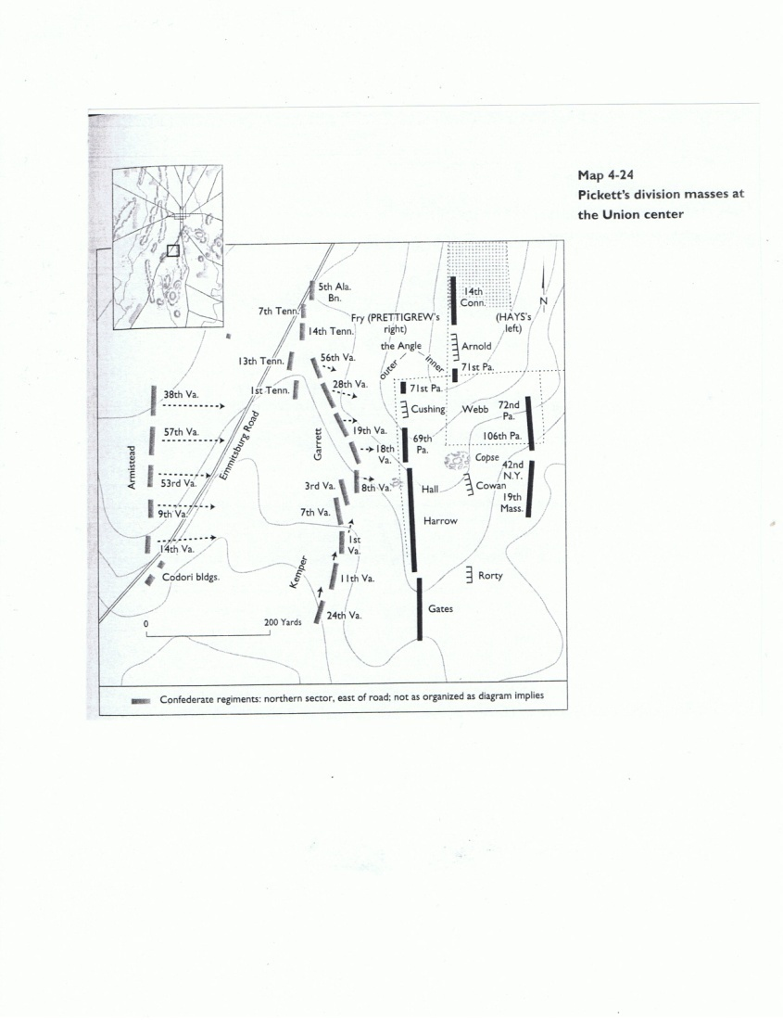
Pickett Masses at Union Center

Slide 28
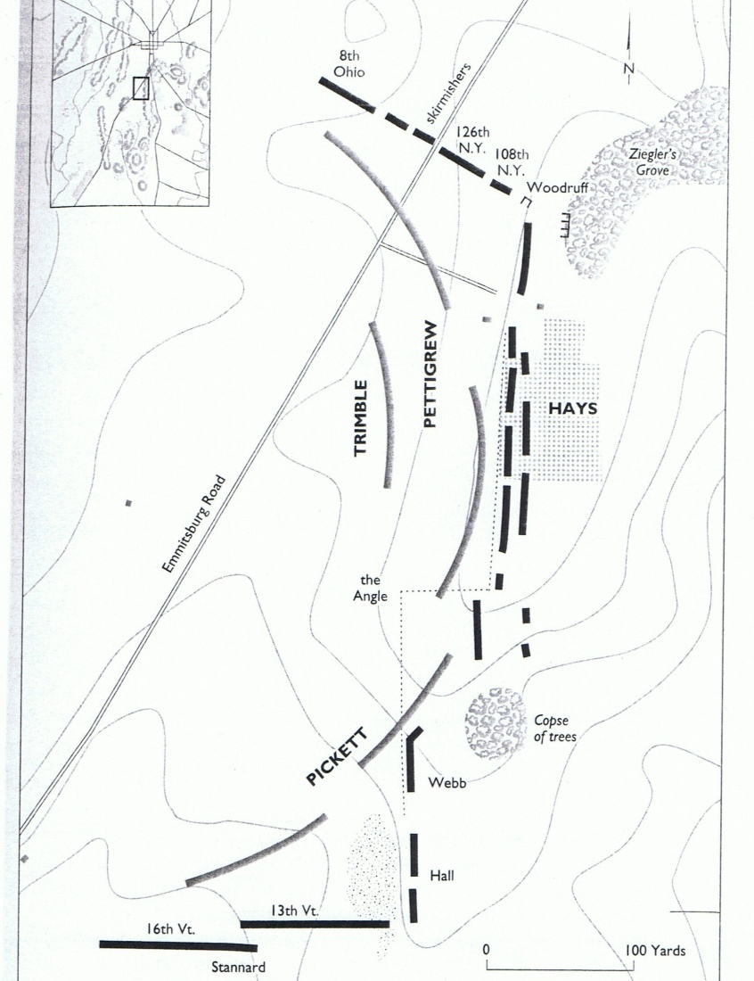
Double Envelopment

Slide 29
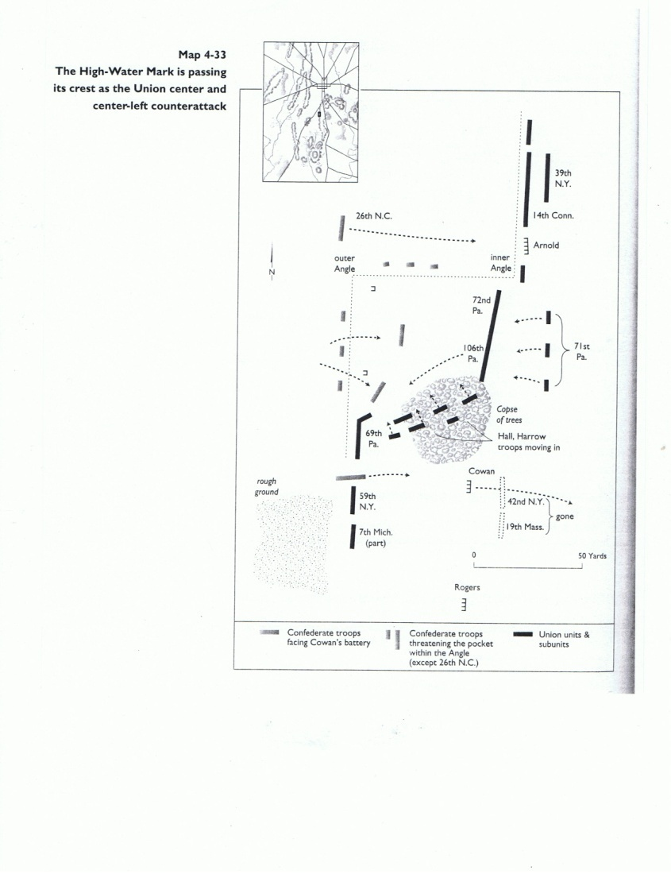
High- Water Mark

Slide 30
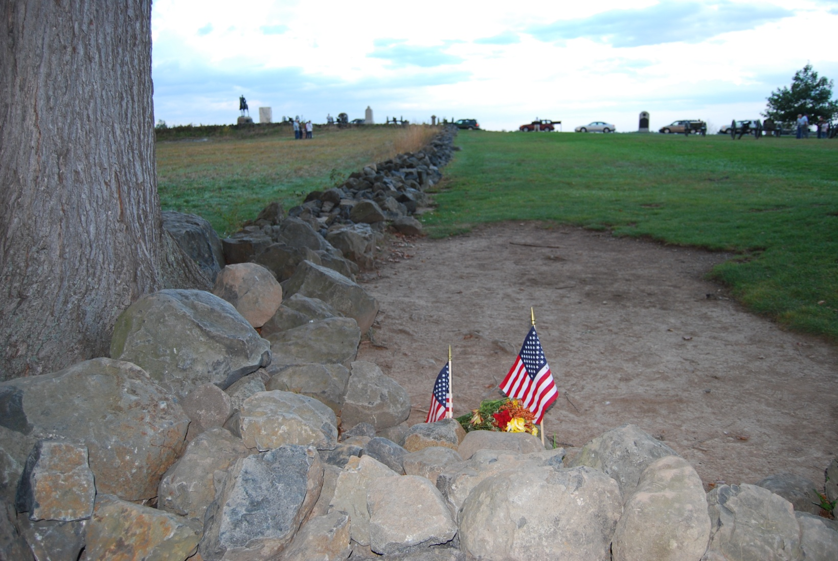
The Angle

Slide 31
Officer Casualties in Pickett’s Division
All three Brigadiers
Thirteen Colonels (eight killed, five wounded)
Of thirty five officers above Captain, one came back unhurt

Slide 32
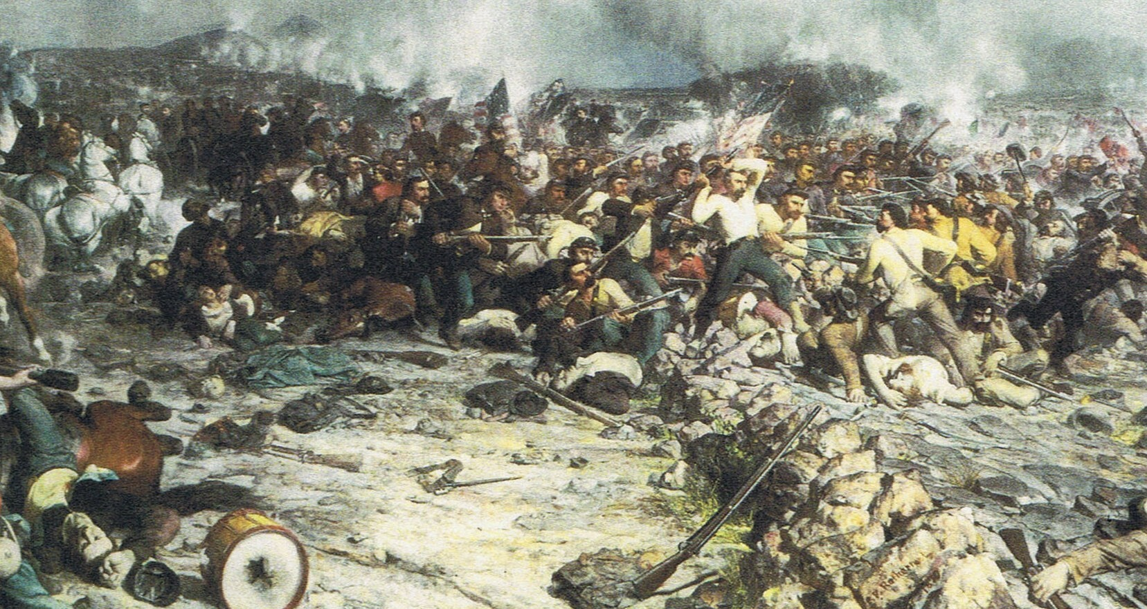
High- Water Mark

Slide 33
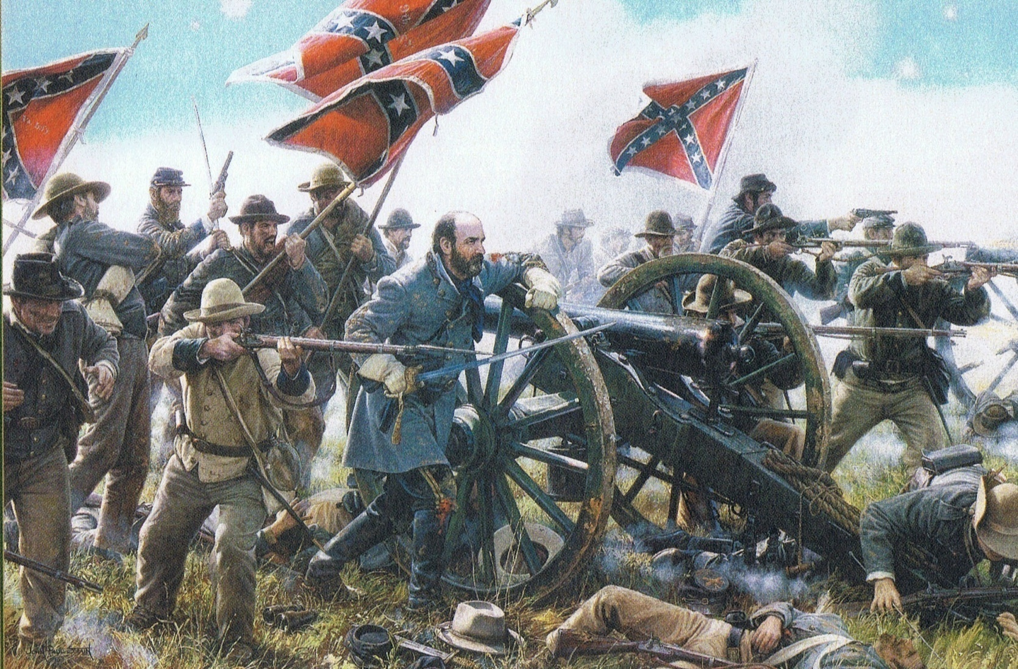
General Armistead at High- Water Mark

Slide 34
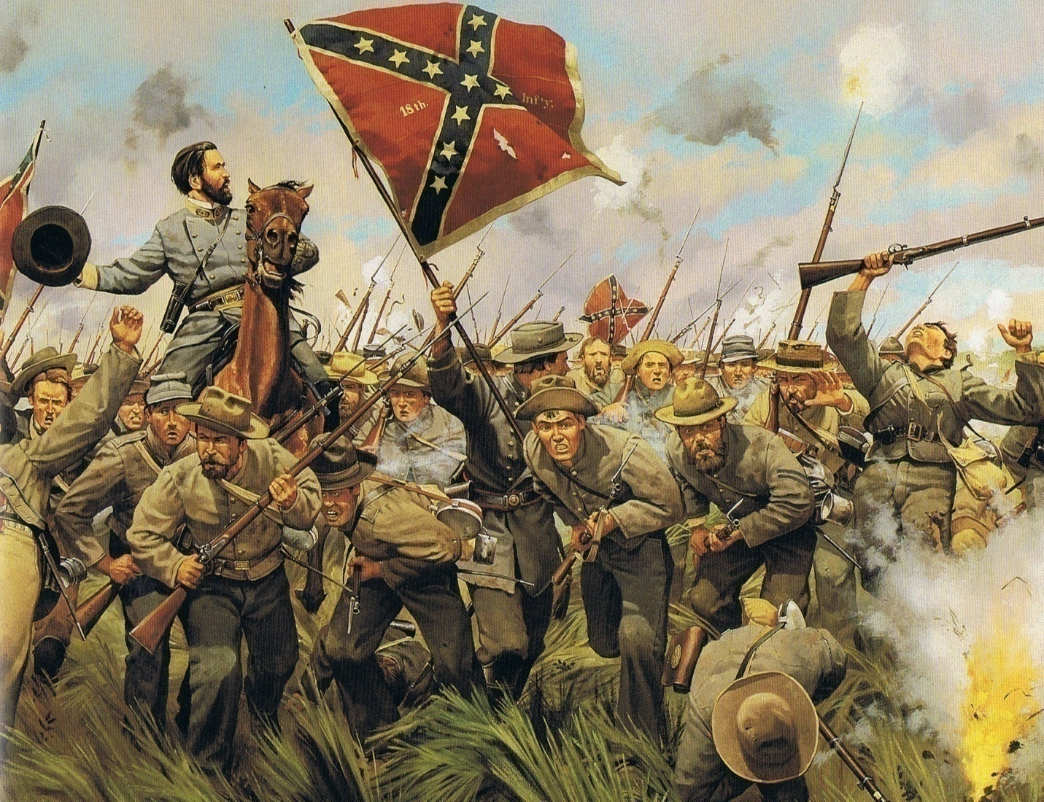
General Garnett at High-Water Mark

Slide 35

Cadmus Wilcox and David Lang’s Brigades Attack and are Repulsed

Slide 36
Summary of Casualties in Battle of Gettysburg
 | Confederate | Union
Day 1 + Day 2 | 20,451 | 21,549
Day 3 | 7,077 | 1,500
Total | 27,528 | 23,049

Slide 37
Reasons for Failure of Pickett’s Charge
Longstreet failed to adequately plan for support on the flanks of the attacking force
The artillery preparation was not well designed.
  Not enough enfilading fire
  Plan for moving the guns forward was not realistic
Insufficient number of troops at point of attack
The most important reason was:

Slide 38
Brigadier General Henry Hunt-Chief of Artillery

Slide 39
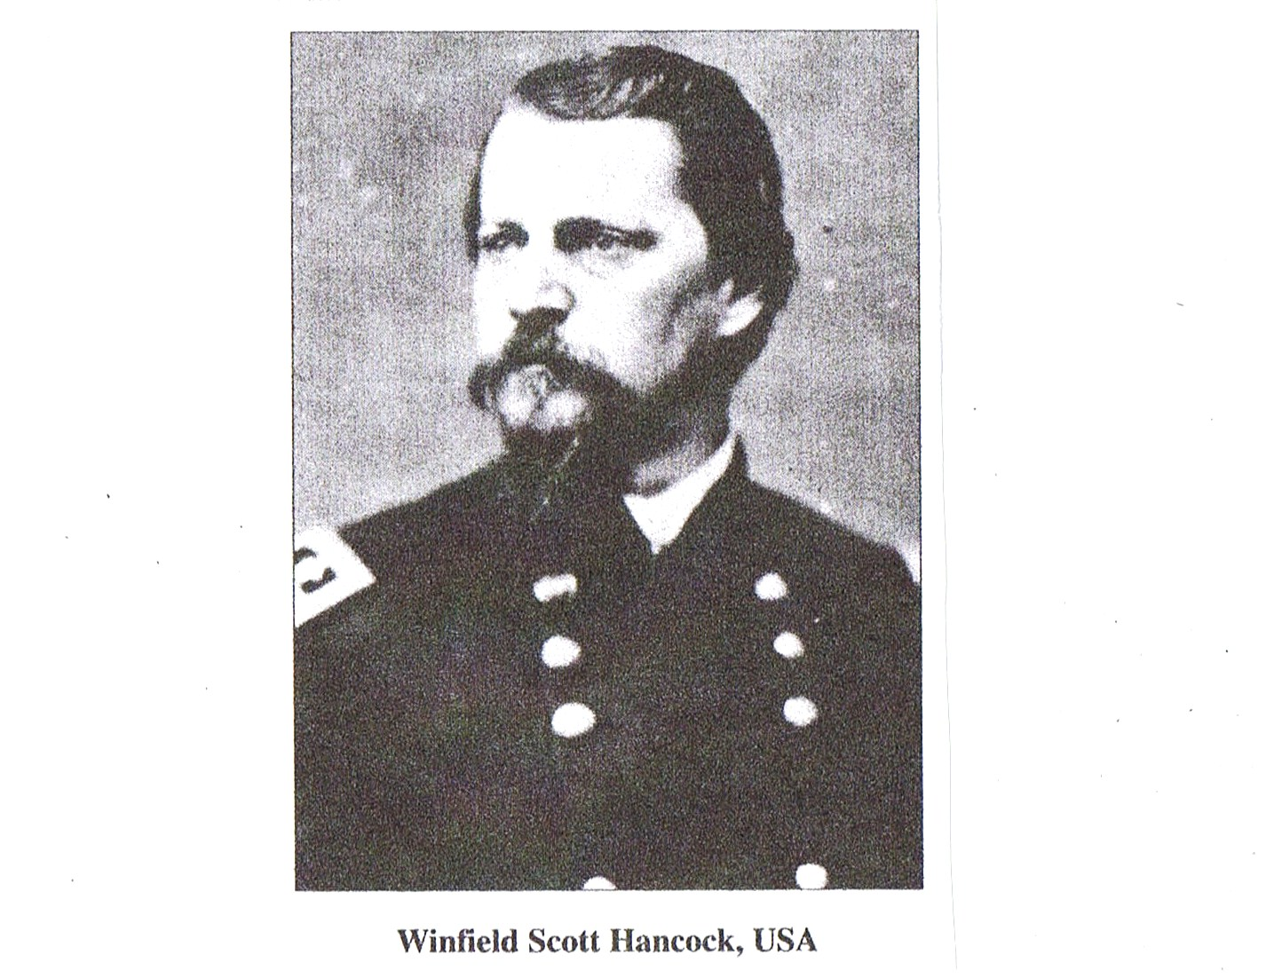
Maj. General Winfield Scott Hancock
Commander of Center of Union Line

Slide 40
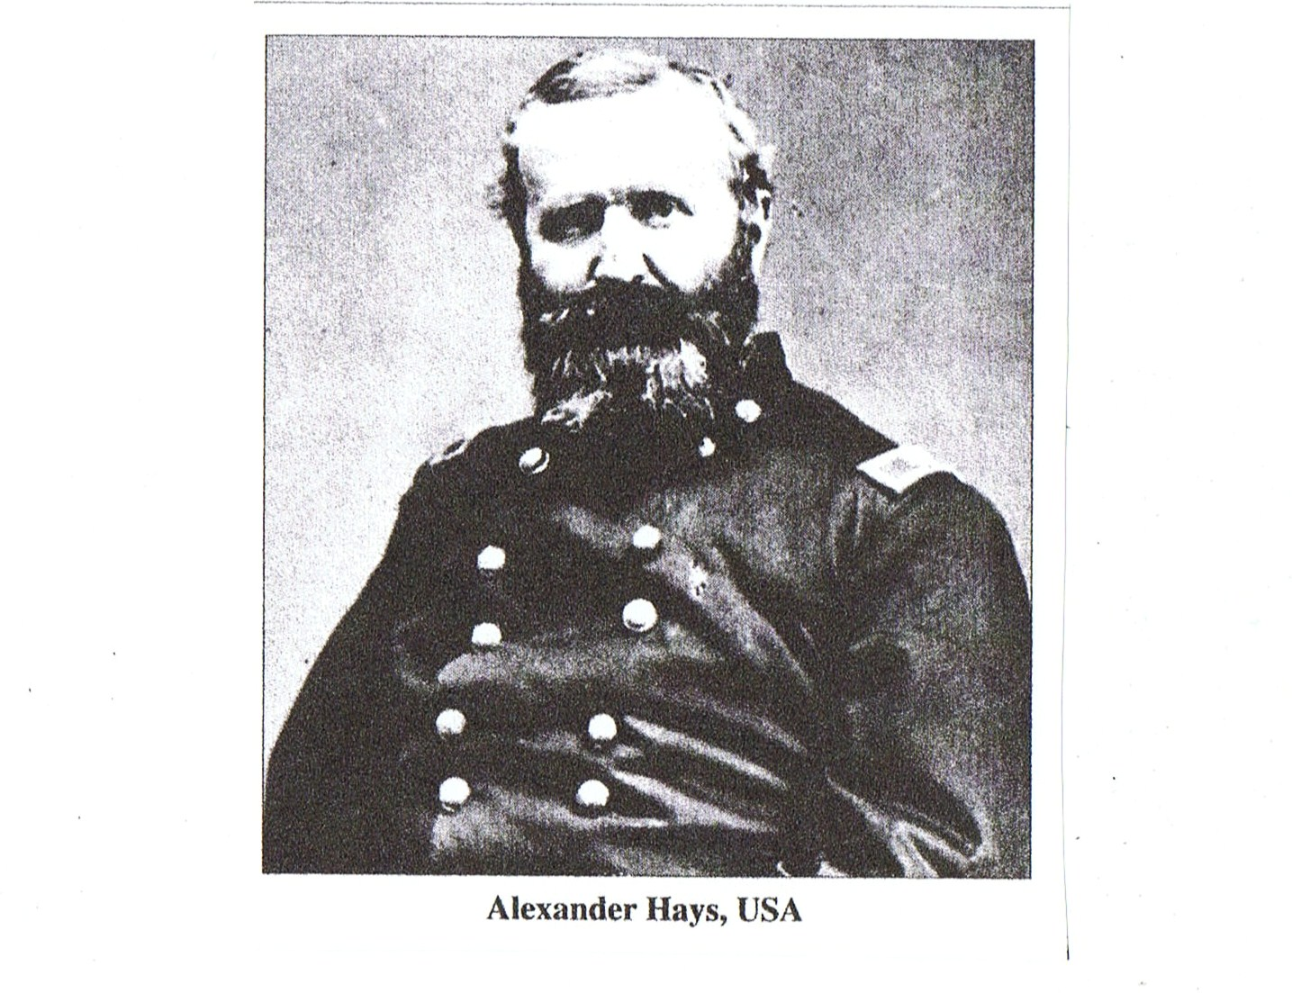
Brig. Gen. Alexander Hays-Commander of Right Flank of 2nd Corps Line

Slide 41
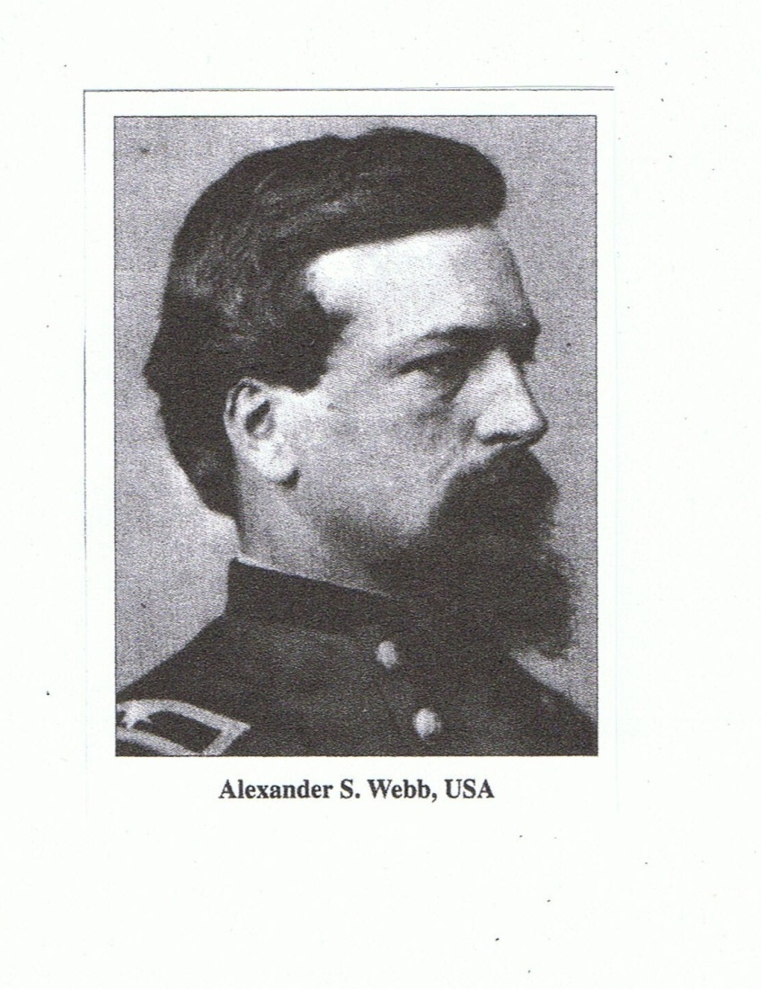
Brig. Gen. Alexander Webb-Brigade Commander in Center of Union Line

Slide 42
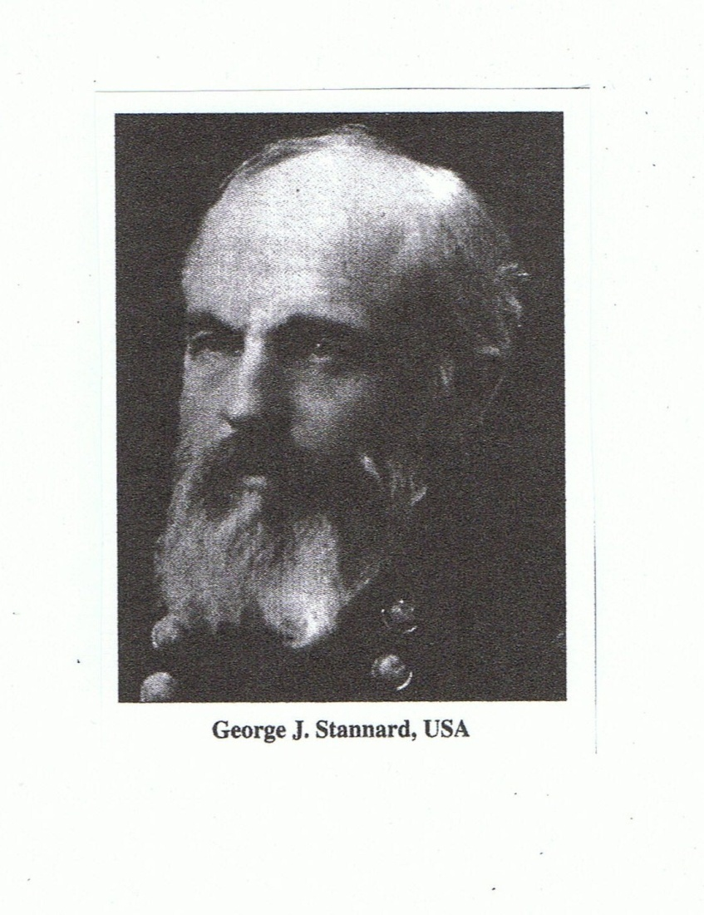
Brig. Gen. George Stannard-Brigade Commander at Far Left Flank

Slide 43
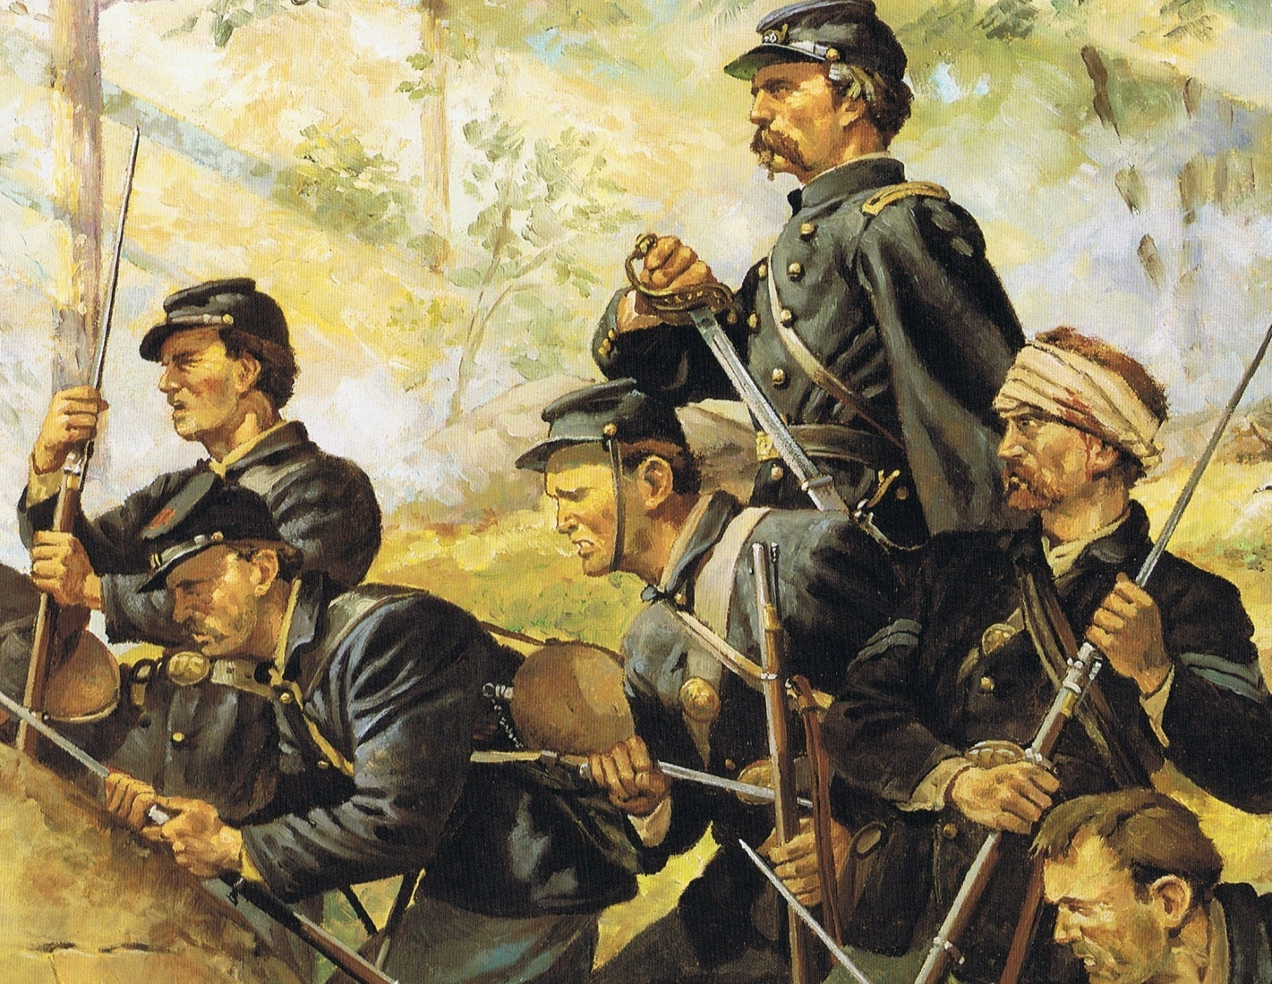

Slide 44
Could Pickett’s Charge have Succeeded?
Pickett came close to breaching the Union line at the Angle and if adequate support had been present there could have been a serious splitting of the Union line
However, the Charge was doomed from the start because Meade had strong reserves available to stop the breach (VI Corps-the largest corps in the army)

Slide 45
General Lee’s Alternatives for the Third Day
Move around Union left flank and attack from the rear
Continue to attack flanks of Union forces
Attack the Union center
Retreat and return to Virginia with supplies gathered in Pennsylvania
Move from Gettysburg and assume a defensive position in Maryland (Longstreet)

